Slide 1
Secure Data Hiding In Images Using Steganography
CAPSTONE PROJECT
Presented By: changa Bujjamma
Student Name : changa Bujjamma
College Name & Department : Mohan Babu University & Master’s Of Computer Applications

Slide 2
OUTLINE
Problem Statement
Technology used
Wow factor
End users
Result
Conclusion
Git-hub Link
Future scope

Slide 3
Problem Statement
Digital communication, Ensuring data security and privacy has become a major challenge. Traditional encryption techniques make data transmission secure but also make the presence of confidential data evident. Steganography, the practice of concealing information within digital media, offers a way to hide sensitive data inside images without raising suspicion. This project focuses on implementing a secure and efficient image steganography technique that ensures confidentiality, integrity, and imperceptibility of hidden data. in that give me presentation

Slide 4
Technology used
Programming Language:
Python 3.x (Core development language)
Image Processing:
OpenCV (Reading, modifying, and saving images)
NumPy (Efficient manipulation of image pixel data)
Steganography Technique:
Least-Significant-Bit (LSB) Encoding (Hiding data within image pixels)
User Interface:
Streamlit (Web-based UI for encryption and decryption)
Data Security:
Passcode-based Access (Ensuring only authorized users can decrypt the hidden message)

Slide 5
Wow factors
🔒 Undetectable Steganography:
Uses Least-Significant-Bit (LSB) encoding, making hidden messages invisible to the human eye and difficult to detect even with digital analysis.
🖼️ No Visible Changes to Images:
The encrypted image looks the same as the original, ensuring stealthy communication without suspicion.
💡 Passcode-Protected Decryption:
Only users with the correct passcode can retrieve the hidden message, adding an extra layer of security.
⚡ Simple & Fast Encryption/Decryption:
Processes messages within seconds, making it efficient for real-time secure communication.
🌍 Web-Based & User-Friendly (Streamlit UI):
No need for a command-line interface—users can encrypt and decrypt messages easily through a modern web app.
📜 Supports Variable Message Lengths:
Can handle different message sizes while maintaining image integrity.
🛠️ Lightweight & Requires Minimal Resources:
Runs smoothly on any system without requiring heavy computational power.

Slide 6
End users
📧 Privacy-Conscious Individuals:
People who want to send confidential messages without drawing attention.
Users who value privacy and secure data transmission.
🕵️‍♂️ Journalists & Activists:
Journalists working in high-risk environments can securely share sensitive information.
Human rights activists can use this method to avoid surveillance.
🔐 Cybersecurity Enthusiasts & Ethical Hackers:
Professionals exploring steganography techniques for security and research.
Cybersecurity experts testing how steganography can be used to protect data.

Slide 7
Results
✅ Successful Message Hiding:
The secret message is embedded in an image without noticeable changes to the human eye.
🔓 Accurate Message Retrieval:
The hidden message is correctly extracted only when the correct passcode is provided.
⚡ Fast & Efficient Processing:
Encryption and decryption processes are completed within seconds, ensuring real-time usability.
🖼️ High Image Quality Retention:
The encrypted image looks identical to the original, making detection difficult.
🛡️ Secure Communication:
The use of passcode protection ensures that only authorized users can retrieve the message.
🌍 User-Friendly Web Interface:
The Streamlit-based UI allows for easy encryption and decryption, making the system accessible to all users.

Slide 8
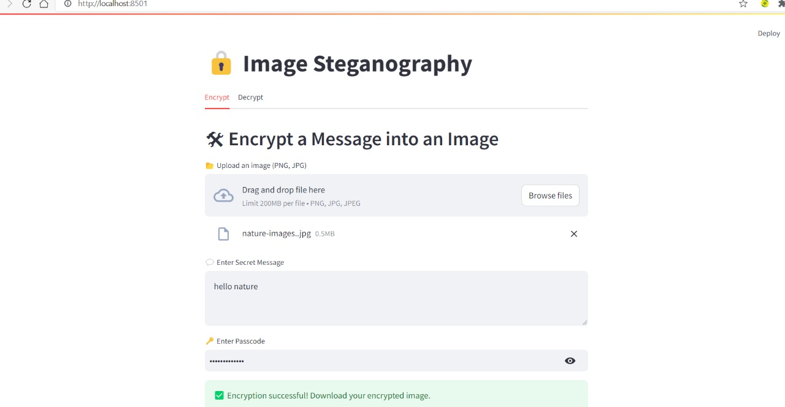

Slide 9
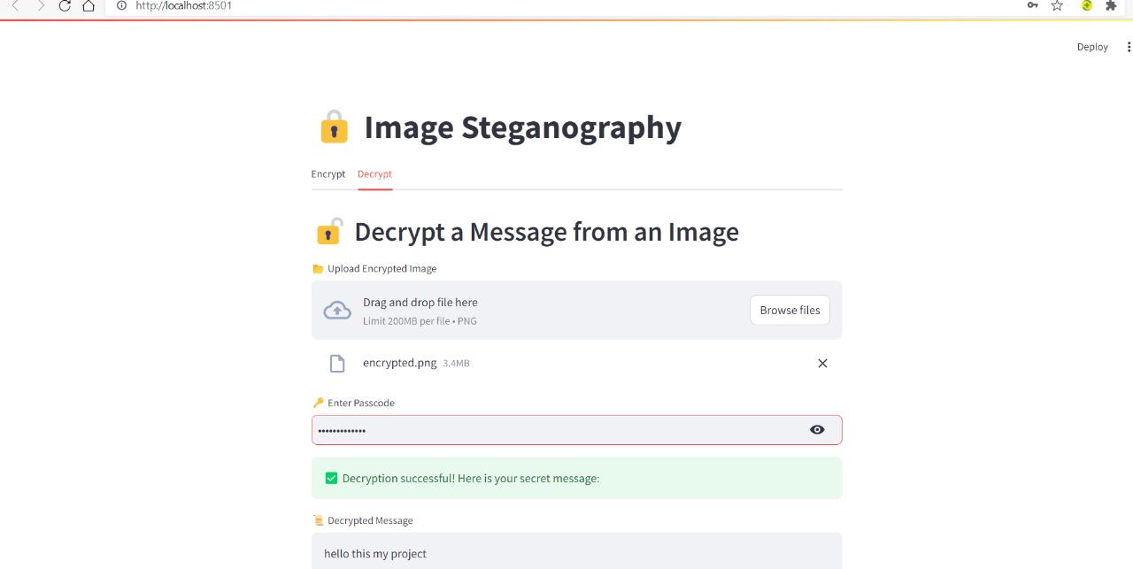

Slide 10
Conclusion
This project successfully implements image steganography using the Least Significant Bit (LSB) technique, providing a secure, efficient, and user-friendly method for hiding and retrieving secret messages within images. By leveraging Streamlit for a web-based interface, users can easily encrypt and decrypt messages without requiring advanced technical knowledge. The passcode-based protection adds an extra layer of security, ensuring that only authorized users can access the hidden information. Furthermore, the technique preserves image quality, making the modifications undetectable to the human eye. With applications in secure communication, cybersecurity, and privacy protection, this project showcases how steganography can be an effective tool for covert data transmission.

Slide 11
GitHub Link
Github source:https://github.com/bujjichanga/secure-data-hiding-in-images-using-steganography/blob/master/output

Slide 12
Future scope
The project can be enhanced by integrating stronger encryption algorithms alongside steganography for an added layer of security. Future improvements may include support for multiple image formats, adaptive LSB techniques to increase storage capacity while maintaining image quality, and AI-driven steganalysis resistance to prevent detection. Expanding the application to video steganography and cloud-based secure message exchange could further enhance its usability. Additionally, implementing mobile and web-based platforms with real-time encryption and decryption capabilities will make the system more accessible and practical for broader use cases in cybersecurity and confidential communication.

Slide 13
THANK YOU

